Slide 1


Vec2Rec
Intelligent Matching for Job Seekers & Head Hunters Alike!

Slide 2
Vec2Rec An Intelligent Recommendation Engine
Job Seekers
Navigate in Job Market
Charge Up with Suitable Training
HR Professionals
Fill Up Ranks with Mr. & Ms. Rights
Best Bang for the Buck in Training

Slide 3
Architecture
Data Sources on S3
Resumes / Training Course Desc / Job Desc
Static in project; real life: pulls in data weekly
Kubeflow Pipeline & Dockers
Each step is a container. Result saved allowing reruns
Gensim Doc2Vec
Tools for data cleaning like stop-words removal, etc.
Unsupervised training for document similarity comparisons
User Interface
Queries: key words or document + return type
Returns – top N jobs, training, resumes or mixed
Or what-if scenarios: resume + training => Top N job (Training effectiveness)
UI Technology – CLI (or Flask if time allows)

Slide 4
Design Objectives
Memoization: Preserve computation steps to allow easy
Modularity / Composability: enable future enhancement / replacement
Enhance parallelization on computation and Memory Efficiency
Allow incremental growth to lookup database
Centralized Repository

Slide 5
Components
Batch processing – Build Gensim Doc2Vec models for similarity lookups
Front end – for Similarity Queries

Slide 6
Batch – Kubeflow Pipeline Phases
Generic preprocessing phase
Gensim Doc2vec preprocessing phase
Gensim Doc2vec training phase
Gensim Doc2vec testing phase

Slide 7
Generic preprocessing phase
Generic preprocessing phase converts raw data, such as Excel and PDF into Pandas Dataframe, which is computed with Dask Dataframe / Dask Delayed, stored as Parquet File format converter is implemented as descriptor to be easily replaceable
Preprocessing includes conversion to lower case, UTF-8 charset, removal of NLTK stopwords and punctuations, and the use of Krovetz Stemmer, which seems to have better conversion results than some others like the NLTK stemming or lemmatization; dropping of short and infrequent words
Preprocessing is implemented as a descriptor to be easily replaceable

Slide 8
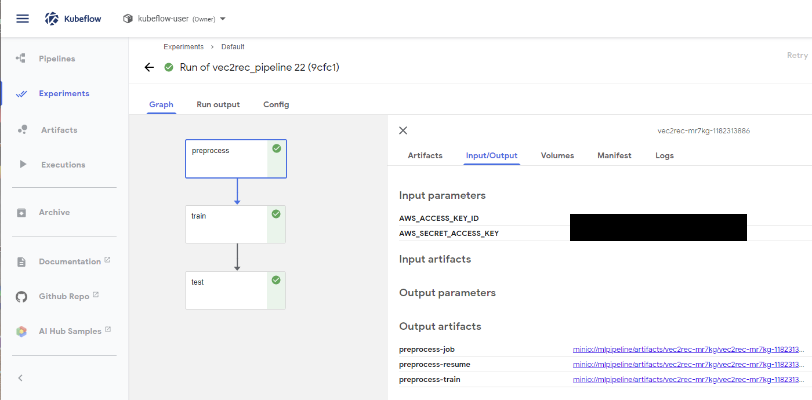

Slide 9
Gensim Doc2vec preprocessing phase
Gensim Doc2vec preprocessing phase split training/testing set in dataframes on Parquet and convert into Gensim Doc2Vec Training and Testing Corpus
Specifically detached from the generic phase to allow Doc2vec engine to be replaced
Final point where incremental updates are possible as Doc2vec models are not.
Currently merged w/ training phase as corpus serialization is not implemented.
Gensim Doc2vec training phase builds the doc2vec model from training corpus
Currently, incremental update is not supported by Doc2Vec the model needs to be retrained whenever there are additions/removal to corpus
Trade-offs for grouping of models
1 Model from each data type – resumes, job desc, train desc (Implemented) - Better retrain performance
Model with all data meshed together (Future Enhancement) - Larger sample size, more complete vocabulary

Slide 10
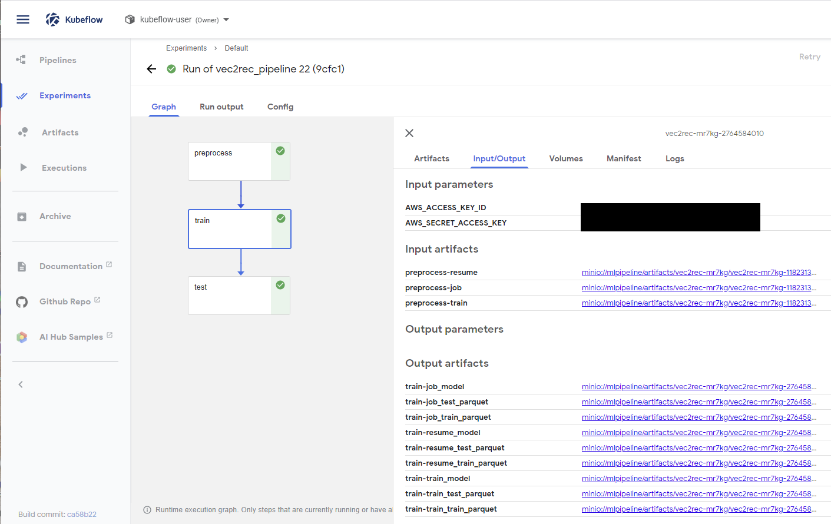

Slide 11
Gensim Doc2vec testing phase
Gensim Doc2vec testing phase uses training / testing for model evaluation
Jobs: 419 / 442 samples – top #1 similar to itself – Good!
Trainings: 190/331 samples – top #1 similar to itself – Need more training / larger vector
Testing data: in this project, eyeball verification is employed though more sophisticated methods are available
The test document #191 picked
Most similar, the least similar and Median listed

Slide 12
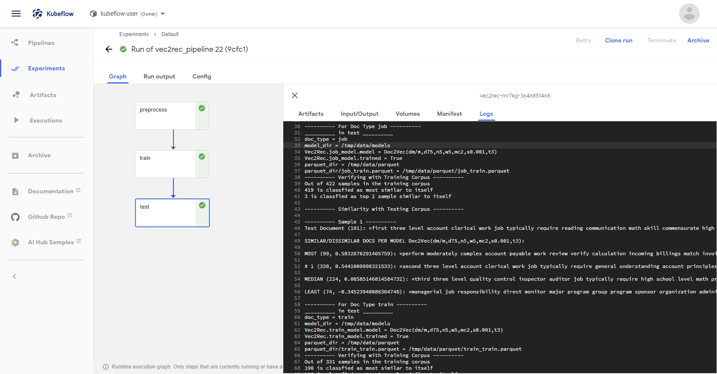

Slide 13
Front end – for Similarity Queries
Includes
CLI Python Module with argparse
Flask API (Future Enhancement)
Features
Lookup
Allows lookup from either text entry, and 1 or more documents (e.g.: Resume + Job)
Returns similarity scores for confidence level
Returns URL + doc ID which can be used to retrieve the original doc
Add Doc / Remove Doc to repo
Preprocess / Training / Testing Phases are also triggered by CLI and called by Kubeflow Dockers

Slide 14
Demo
Lookup with Text
Lookup with File
What-if scenario: Find jobs from this resume after training

Slide 15
Package Structure
https://github.com/crispin-nosidam/2020sp-vec2rec-crispin-nosidam

Slide 16
Future Enhancements
Weighted importance based on
record age – with decaying importance
user preferences based on past search and selections
add user profile for matching, if available
Migration of S3 to database for better retrieval performance
Visualization with Roadmaps with Resume being a starting point and jobs being goals (can be multiple), with each training being steps in the middle
Serialization of Gensim Training / Testing Corpus with pickle to reduce repeated computation after adding samples.
Another training module which allows incremental sample addition without total retrain.
Support conversion from MS Word for resume.
Front end replaced by a chatbot

